Slide 1
PROJECT PRESENTATION OF WEB DEVELOPMENT FRAMEWORK USING PYTHON (24CAI0105)
On
Blood Management System
Submitted by: Supervised By:
Yashu Singla (2410993076) Mr. Pavan Ambulkar
Yuvraj Garg (2410993081) (Mentor)
Ishmeet Singh (2410992764)
Dhritvan Garg (2410993010)
Department Of Computer Science And Engineering
(Artificial Intelligence)
Chitkara University, Punjab

Slide 2
Tables of Content
Introduction
Problem Statement
Technical Details
Key Features
Project Highlights
Conclusion
References/Links used

Slide 3
Introduction
The Blood Management System (BMS) is a web-based application designed to streamline the processes of blood donation, collection, storage, and distribution in hospitals and blood banks. This system aims to improve the efficiency and effectiveness of blood management, ensuring that blood is readily available for patients in need.
Key features of the system include:
Donor registration and management
Blood inventory tracking
Built using Django, HTML, CSS, JavaScript, SQLite and SQLAlchemy for the back-end database.
Overcame challenges with secure authentication, data management, and performance optimization.
3

Slide 4
Problem Statement
The management of blood donations and blood bank inventories remains a significant challenge in healthcare systems. Several issues hinder the efficiency and effectiveness of blood management:
Blood Shortages: Blood banks often face supply shortages due to irregular donation patterns, lack of awareness, and inefficient tracking of blood inventory.
Manual Processes: Traditional blood management systems rely on manual entry and paper-based tracking, leading to errors, delays, and mismanagement of blood supplies.
Inefficient Blood Allocation: Blood donations are not always optimally allocated to patients in need, leading to potential wastage or shortages in critical situations.
Lack of Real-Time Updates: Many systems fail to provide real-time data on available blood stock, which makes it difficult to respond quickly to emergency situations or manage donor scheduling effectively.

Slide 5
Objectives of the Project
Automate Blood Donation Process: Simplify registration, scheduling, and
tracking of donations to enhance efficiency.
Real-Time Blood Inventory Tracking: Monitor blood levels and alert for low stocks
to prevent shortages.
Improve Donor Engagement: Provide donors with an easy-to-use platform for
registration, scheduling, and notifications.
Efficient Blood Allocation: Ensure timely and optimal distribution of blood to
hospitals and patients in need.
Increase Operational Efficiency: Minimize manual errors and reduce
administrative workload through automation.
Provide Real-Time Notifications: Keep users informed with updates on blood
stock, appointments, and critical alerts.

Slide 6
Technical Details
Frontend:
HTML & CSS: Used for structuring and styling the web pages to create a
user-friendly and responsive interface.
Flask: Handles the frontend logic, rendering dynamic content using Jinja templates.
Backend:
Django: A powerful framework used for backend development, managing database
operations, user authentication, and complex API integrations.
API Integration:
REST API: Enables smooth communication between the frontend (Flask) and
backend (Django) for real-time data processing, such as donor registration,
blood inventory management, and scheduling.
Database:
SQLite : Used for securely storing donor information, blood inventory, and other
critical data.

Slide 7
Key Features
User Registration and Management:
Donor signup/login functionality.
Track past donations and upcoming schedules.
Blood Inventory Management:
Track stock levels of different blood types.
Appointment Scheduling:
Allow donors to schedule donation appointments.
Automated reminders.
Notifications and Alerts:
Real-time updates on blood stock and donor status.

Slide 8
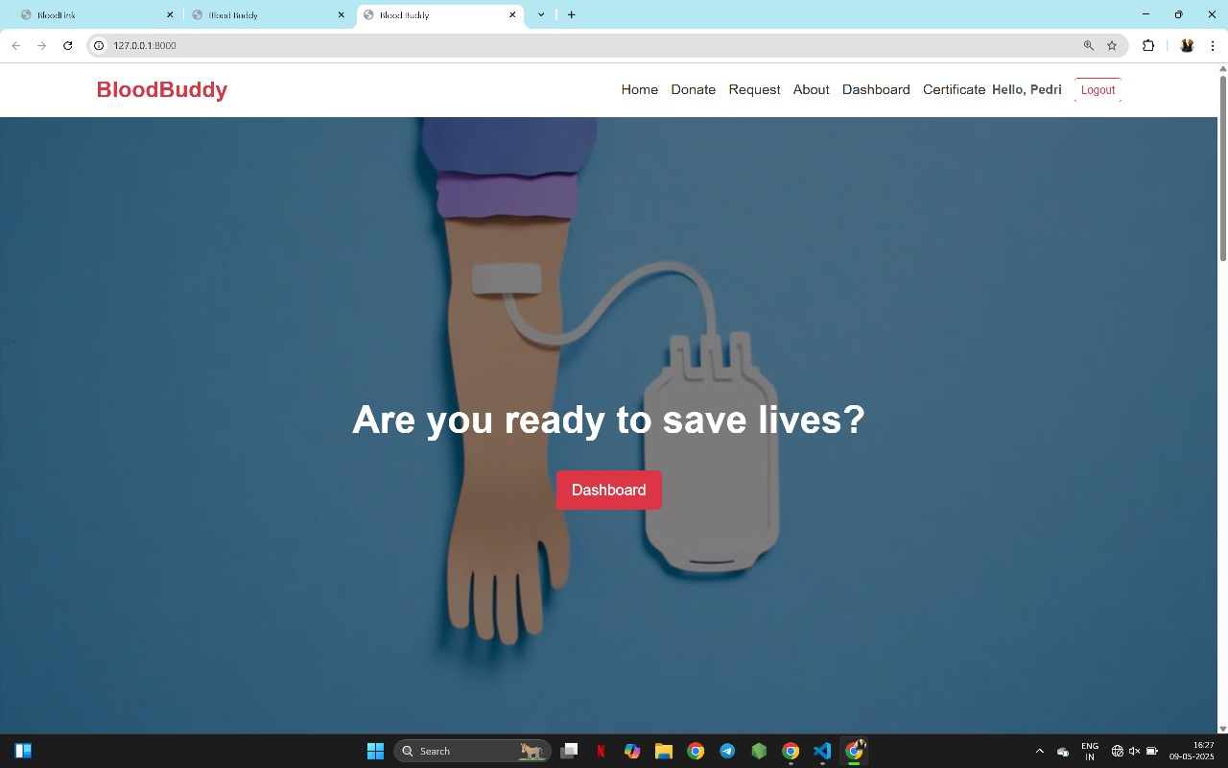
Project Highlight
Landing Page

Slide 9
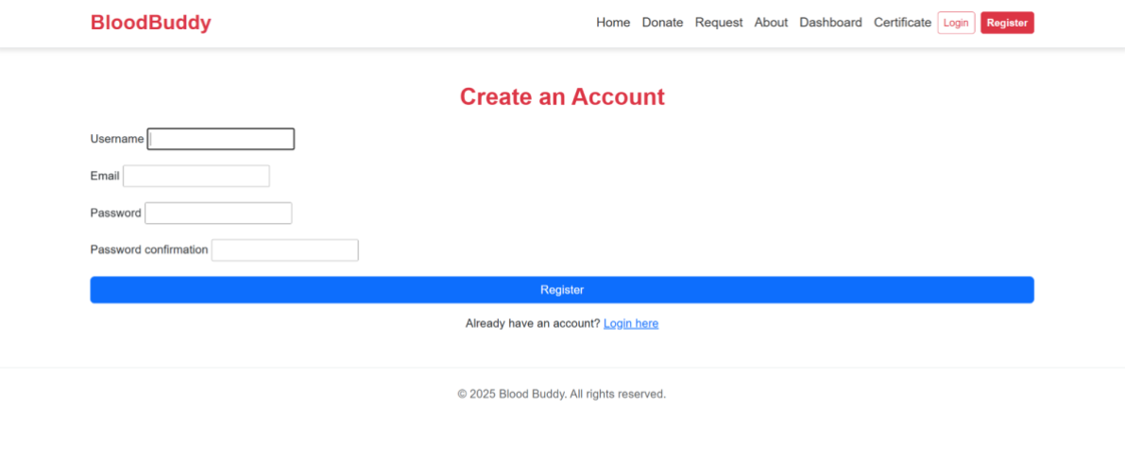
Project Highlight
SignUp Page

Slide 10
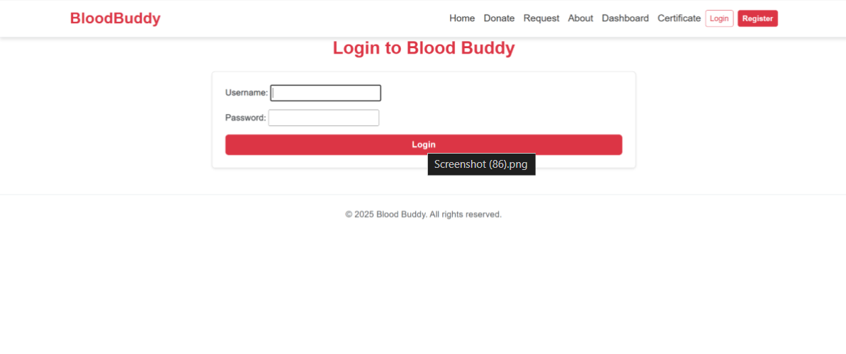
Project Highlight
Login Page

Slide 11
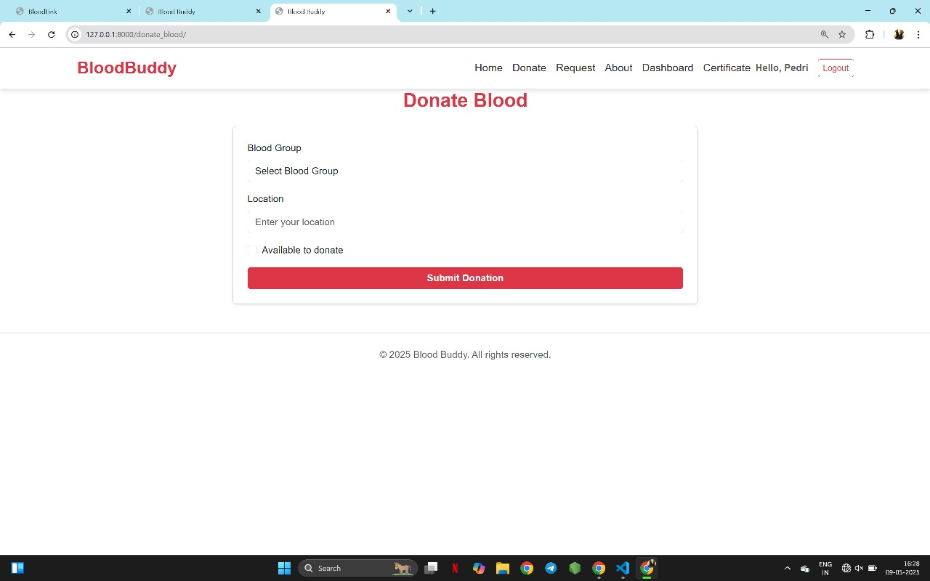
Project Highlight
Donation Page

Slide 12
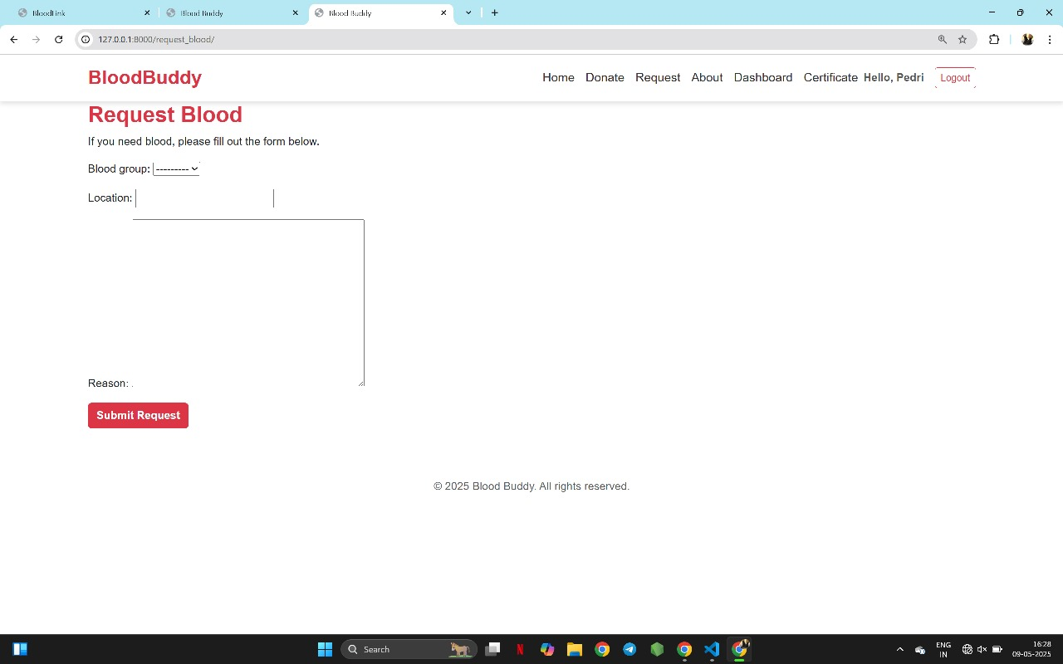
Project Highlight
Request Page

Slide 13
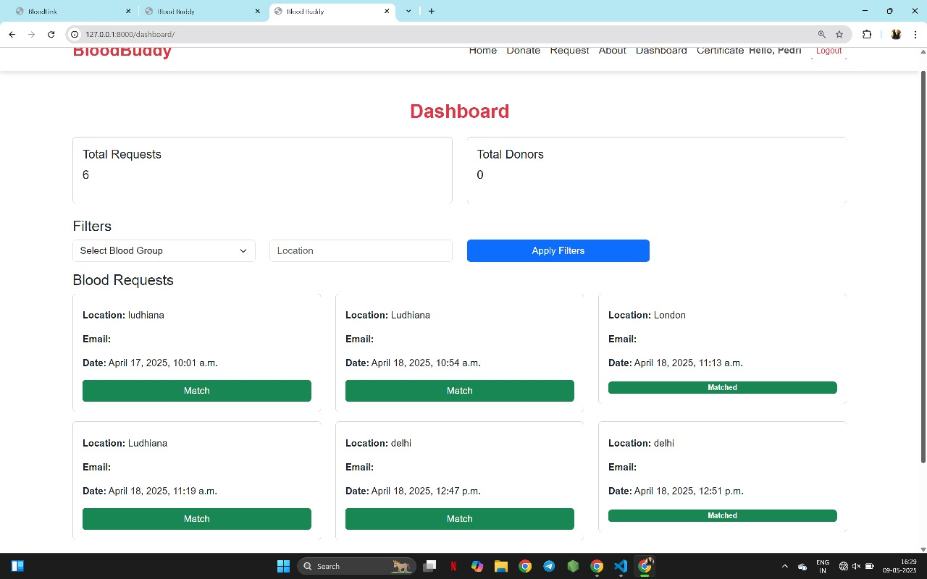
Project Highlight
Dashboard Page

Slide 14
Conclusion
The Blood Management System successfully addresses key challenges in blood donation and inventory management by providing an automated, web-based solution.
Through the integration of Flask, Django, REST APIs, and a secure database, the system ensures efficient donor registration, real-time inventory tracking, and timely blood allocation.
The platform enhances operational efficiency, reduces manual errors, and improves communication between donors and administrators.
This project demonstrates how web technologies can be leveraged to support critical healthcare infrastructure and save lives.

Slide 15
Links and References Used
Django Documentation
https://docs.djangoproject.com
Flask Documentation
https://flask.palletsprojects.com
Google for general research
https://www.google.com
Adobe Fonts for getting Fonts
https://fonts.adobe.com
CSSGradient.io for theme and color matching
https://cssgradient.io/gradient-backgrounds
Stackoverflow for community research
https://stackoverflow.com/questions

Slide 16
Thank You
16

